Slide 1
CPRG 200
Day 5

Slide 2
Day 5 Agenda
Defining and using classes
Lists; object composition
Reading:
Chapters 12-13

Slide 3
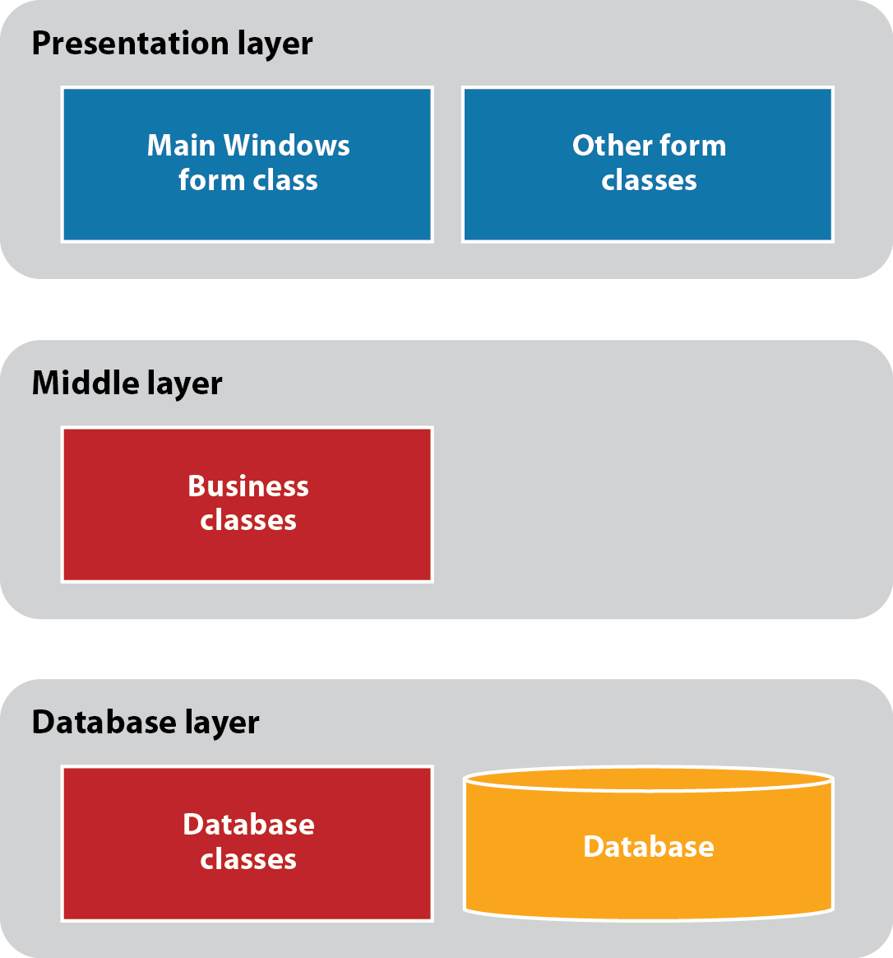
The architecture of a three-layered application

Slide 4
Classes
A class is the code that defines data and methods of objects
Properties define characteristics of an object
Methods defines operations of an object
Constructors are special methods that execute when an object is created
Class serves as a template according to which objects are built
The properties, methods, and events that a class defines are called members of this class
Other kinds of members can be added

Slide 5
Types of class members

Slide 6
Types of class members (cont.)

Slide 9
Objects
You can create multiple objects of the same class
An object is called an instance of the class from which it was created
It has all properties and methods, and responds to events that the class defines
Each object is an autonomous unit: two different objects of the same class may have different values of their properties
Yet, they all have the same set of properties and methods, and respond to the same kind of events that are defined by the class

Slide 10
Two Product objects that have been instantiated from the Product class

Slide 11
Creating Class Objects
Product newProd = new Product(1234, “Gizmo”, 9.99, 5);
Of course, the arguments can be (and typically are) variables, rather than literal constants
newProd
code
1234
description
“Gizmo”
price
9.99
quantity
5

Slide 12
Encapsulation and Data Hiding
Encapsulation is one of the fundamental concepts of the object-oriented programming
Data of a class is encapsulated inside the class objects using data hiding. We accomplish it by making the data private members of the class
The code that performs operations is also encapsulated, so it can be changed without changing the way other classes use it (the other class needs to know only the header of the method: its name, parameters, and return type)

Slide 13
Accessing Members
Inside the class code, we just refer to the member by name
Outside of the class, we use “dot” notation, specifying first from which object, and then which member:
objectName.memberName
However, in order for this to work, the member must be public
Problem: data is hiddent (private)
For example, we cannot refer to the new product’s price: newProd.price
Solution: public properties

Slide 14
Programming Demo
Let’s create a Console Application with a simple class, instantiate a couple of objects and test them

Slide 15
Public Property
Built around a private data member
Typically the same name as the private data member, only starting with a capital letter
Allow accessing value of the private data and/or setting value of the private data
Can be used both inside and outside the class code

Slide 16
Defining Property
//private data
private decimal price;
// public property
public decimal Price
{
get
{
return price;
}
set
{
price = value;
}
}
Allows: total += newProd.Price;
Allows: newProd.Price = 29.99;

Slide 17
Auto-Implemented Property
public decimal Price { get; set;}
This is equivalent to the code from the previous slide
Private data is created automatically

Slide 18
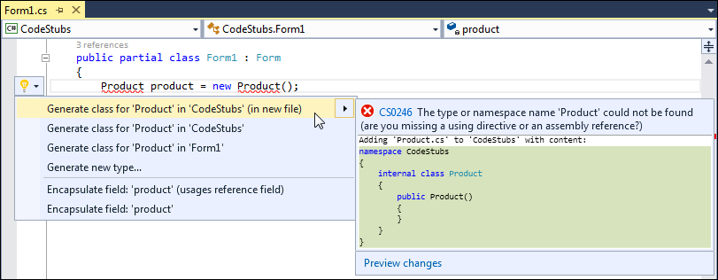
Using live code analysis to generate a class

Slide 19
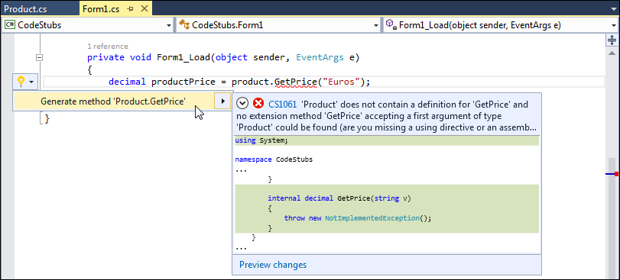
Using live code analysis to generate a method stub

Slide 20
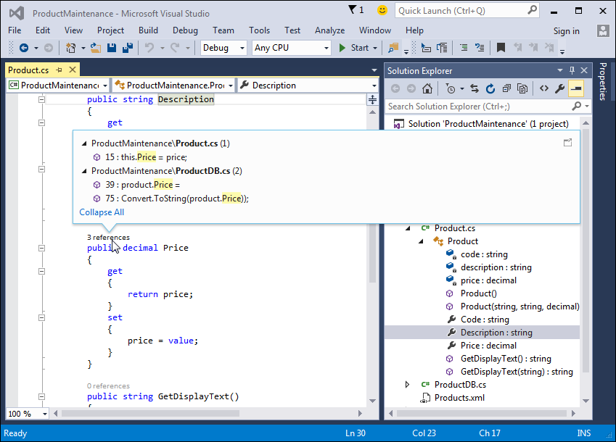
The Product class in the Solution Explorer with references to the Price property displayed*

Slide 21
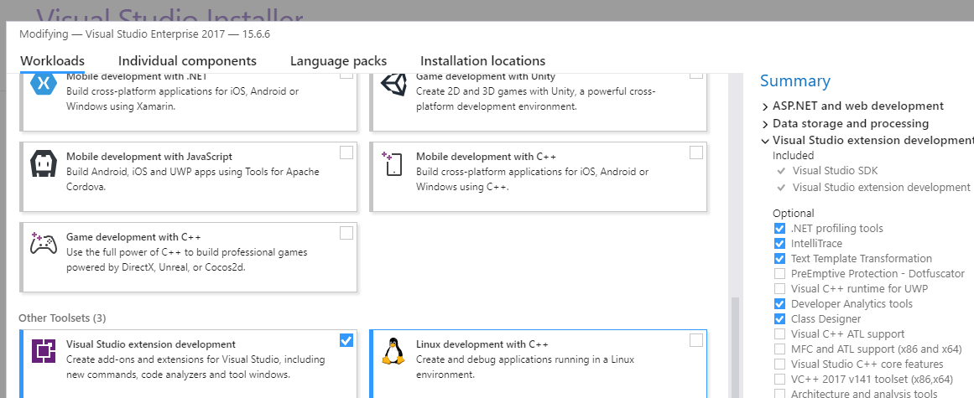
Generate class Diagram
In Visual Studio 2017, we need to include Designer Tools in order to generate class diagram
Tools -> Get Tools and Features
In Visual Studio Installer, check Visual Studio Extension Development and Class Designer

Slide 22
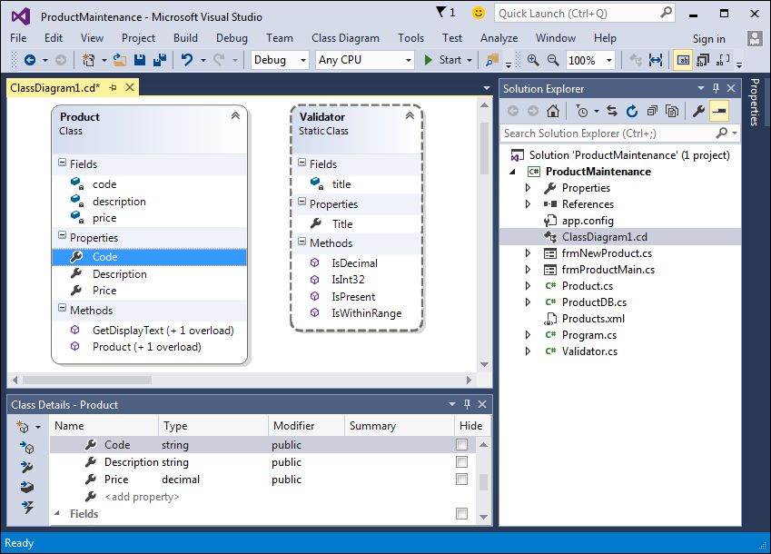
A class diagram that shows two of the classes

Slide 23
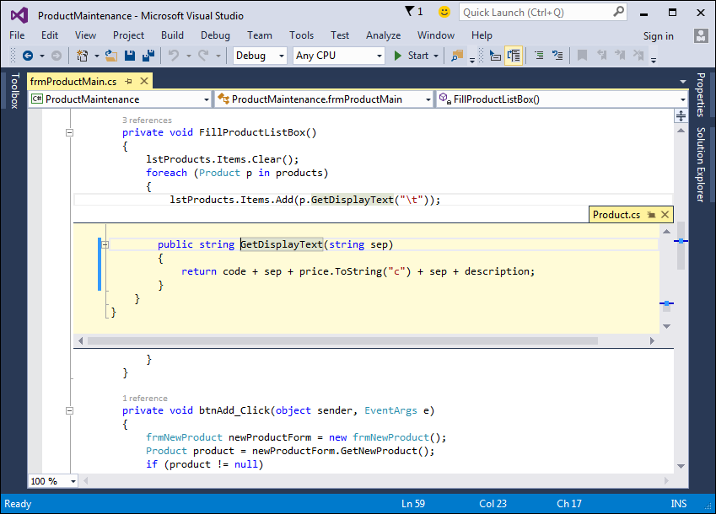
A Peek Definition window with the code for the GetDisplayText method

Slide 24
Structures
Similar to class
Can have the same type of members as class
Structure is a value type, while class is a reference type
Cannot include default constructor, because compiler always generates one
Use for small objects

Slide 25
Creating a List of Products
List<Product> products = new List<Product>();
In the button Add procedure, after getting values for the new product’s code, description, price, and quantity from text boxes:
Product newProd = new Product(code, description, price, qty);
products.Add(newProd);

Slide 26
To Display all Products
private void DisplayProducts()
{
lstProducts.Items.Clear();
foreach(Product prod in products)
{ lstProducts.Items.Add(prod.GetDisplayText());
}
}

Slide 27
To Discount All Products
percent = Convert.ToInt32(txtPercent.Text);
foreach (Product prod in products)
{
prod.DiscountPrice(percent);
}

Slide 28
A Few Useful Techniques
ToString() method
Overloading constructor
Default parameter values
Using static member

Slide 29
ToString() Method
Defined in Object class (all classes inherit from it)
Can be redefined
No parameters, returns string type
Example:
public override string ToString()
{
return code.ToString() + ", " +
description.ToString() + ", " +
price.ToString("c") +
": " + quantity.ToString();
}

Slide 30
Using ToString() Method
Can be used to display object data
No need to call it; it is implicitly called whenever the entire object is displayed
“Converts an object to string”
Example:
Product p1 = new Product(123,
"lunch box", 12.99m, 15);
Console.WriteLine(p1);
Object reference

Slide 31
Default Constructor
When you do not write a constructor, the C# compile provides a default constructor that just creates an object, and does not initialize any data
BUT: This works only when there is no constructor with parameters coded in the class
In order for this code to work, you need to add a default constructor (no parameters):
Product p2 = new Product();

Slide 32
Default Constructor Example
In the default constructor, you can supply default parameter values
public Product()
{
code = 0;
description = "unknown";
price = 0m;
quantity = 0;
}

Slide 33
Default Parameter Values
Alternative to providing default constructor
You can specify default parameter values in the parameter list of a method (also constructor)
Syntax: data_type parameter_name = default_value
Restriction: all parameters with default values must be listed AFTER all parameters that have no default values
If the argument is provided, it will be used to initialize data, otherwise, the default value is used

Slide 34
Constructor with Default Parameters
public Product(int c = 0,
string d = "unknown",
decimal p = 0m, int q = 0)
{
code = c;
description = d;
price = p;
quantity = q;
}

Slide 35
Using Static Members
Static members are defined for the class as a whole rather than for each object separately
A static member is shared between all objects of the class (one copy)
Example: Object count
Can be used to automatically generate unique numeric code

Slide 36
Using Lists
List<T> class
T is a generic type that needs to be substituted with a concrete type if elements of list
List can grow dynamically: start with creating an empty list and add elements to it as needed
List has methods for sorting, searching and manipulating lists
https://msdn.microsoft.com/en-us/library/6sh2ey19%28v=vs.110%29.aspx

Slide 37
Programming Demo
Let’s create a Windows Forms Application that uses the Product class to allow the user to enter data of multiple products
Data is stored in List<Product>

Slide 38
Object Composition
Class object has a data member that is a reference variable of another class type
Implements aggregation relationship; for example: Deck has Cards

Slide 39
Group Class Exercise (1)
Work in new project groups
Create an application that creates a deck of 52 cards.
Individual card should be an object of class Card. Each card has rank and suit. Both data items should be read-only
You may want to use enumeration types to represent possible values of rank and suit:
public enum Rank { Ace = 1, Two, Three, Four, Five,
Six, Seven, Eight, Nine, Ten, Jack, Queen, King }
public enum Suit { Club, Diamond, Heart, Spade }
Class Card needs to have a constructor and ToString() method

Slide 40
Group Class Exercise (1)
Define class Deck that has an array or list of 52 Card objects. Generate them so that there is one card for each rank and suit combination.
In class Deck provide a method Shuffle that shuffles the deck of cards (rearranges them in random order)
You will need to use a pseudo-random numbers generator, for example class Random:
Random gen = new Random();
Expression gen.Next(52) returns a random number from 0..51
You application should at the minimum create a deck of cards, display them in the original order (as they were created)
When the user clicks of the Shuffle button, the order of the cards in the deck changes and the application displays the cards in the new order
If you have time and energy you can add Player class and code some card game, but this is NOT required

Slide 41
Class Discussion
Let’s show the results of the programming exercise
Please share:
What did you learn?
Did you encounter any interesting problem? How did you solve it?

Slide 42
Introduction to Unit Testing
Unit testing - testing pieces of code (methods, classes) in isolation
Gain confidence that components work in isolation before putting them together
Organized approach to catch logic errors
Tests are saved; can be re-run when code changes
Provide some form of documentation
Still need for integration testing
TDD – Test Driven Development – first write tests, then code

Slide 43
Internet Resources
Basic explanation
https://msdn.microsoft.com/en-CA/library/hh694602.aspx
A walkthrough: creating and running unit tests
https://msdn.microsoft.com/en-us/library/ms182532.aspx
Generate unit tests with IntelliTest (Visual Studio Enterprise needed)
https://msdn.microsoft.com/en-CA/library/dn823749.aspx

Slide 44
Arrange-Act-Assert Test Structure
Arrange – initialize objects and data to be passed to the method under test
Act – invoke the method under test with the arranged parameters
Assert – verify that the method behaves as expected

Slide 45
Unit Testing Demo
Create SUT (System Under Test) -a class library project with a simple class that has a public method
Account with Withdraw method
Right-click inside the code editor and select Create Unit Tests
A window pops up where you can change or accept defaults
Write code for the test methods (Arrange-Act-Assert)
Build the solution
To see Test Explorer, choose Test ->Windows -> Test Explorer
Run tests from the Test Explorer window
Demo

Slide 46
More Test Method Attributes
Method throws an exception
[TestMethod()]
[ExpectedException (typeof(ArgumentException))]
public void MyTest(){…}
Set a timeout
[TestMethod()]
[Timeout(2000)] // milliseconds
public void MyTest(){…}

Slide 47
Test Setup and Teardown
Test Setup
Gets executed before the first test
For example: open database connection, create particular object
Attribute [ClassInitialize]
Test Teardown
Gets executed after all tests
For example: close database connection, delete particular file
Attribute [ClassCleanup]

Slide 48
Manually Creating Unit Tests
Create a class library project – System Under Test (SUT) – and a public class that you want to test, with some public methods
Create a test project using Unit Test project template
Add reference of the SUT project
Create Test class – attribute [TestClass]
Create Test methods – attribute [TestMethod]
Execute using Visual Studio Test Explorer

Slide 49
Test Driven Development
Red
Write failing tests
Create an interface that contains headers of the SUT methods
Create an SUT class that implements this interface but all methods throw NotImplementedException
Create UnitTest project with test class and test methods
Green
Make the tests pass in a simplest way possible
Add code to the SUT class
Refactor
Cleanup the code, remove duplication, etc.

Slide 50
This Is It
Assignment 2 is up – due the first day of the second part of the course
You will define a class and unit tests for it

